Slide 1
DLA Track 1: 3D Design and Virtual Reality Macalester Spring Professional Activities Workshop 2016
Bret Jackson and Austin Mason

Slide 2
Workshop Mechanics
A lot of focus on creating virtual environments with Unity and Sketchup
Tentative Schedule:
Session 1: What is VR, Example applications, Intro to Unity with a Museum Demo
Session 2: Resources for finding and creating 3D models
Session 3: Getting around in VR (Interaction/Selection/Navigation)
Session 4: Activity and Show-and-Tell

Slide 3
What do we mean by Virtual Environment or Virtual Reality?

Slide 4
What are the defining characteristics of VEs (VR)?
Virtual environment (VE): a 3D computer generated world seen from a first-person point of view, where the viewpoint is under the real-time control of the user.
Immersive VE: has more realistic sensory outputs than typical desktop 3D graphics; usually appears to surround the user in space.

Slide 5
VR Applications (beyond gaming)

Slide 6
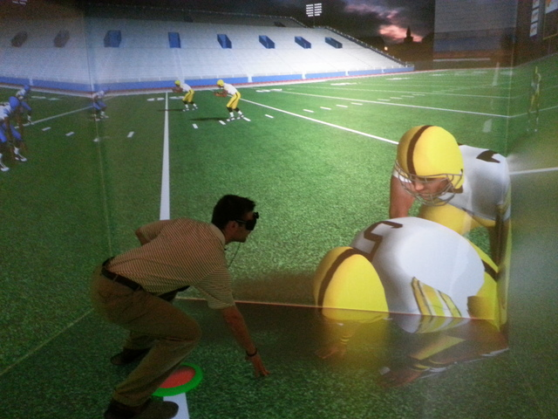
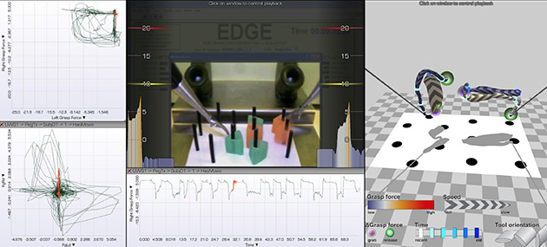
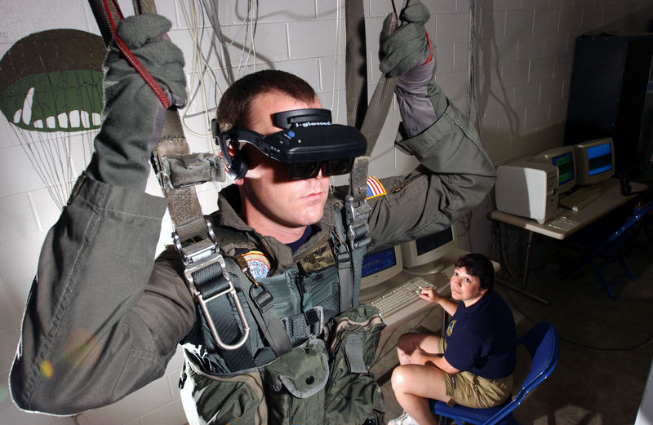
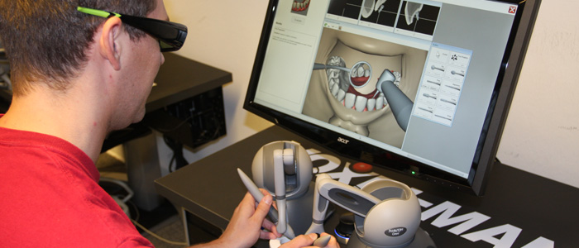
Training
Surgical Training
Sports
Military

Slide 7
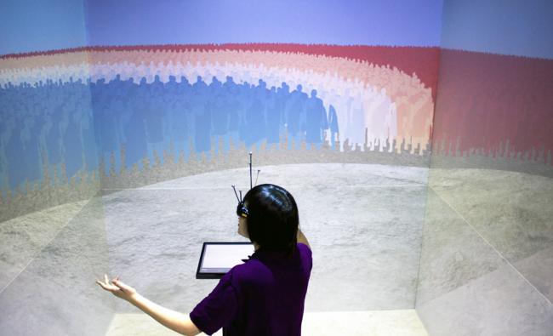
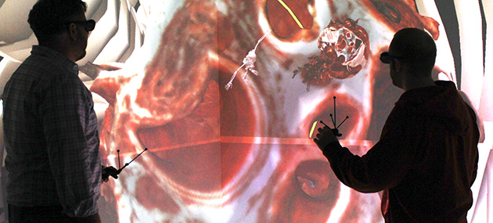
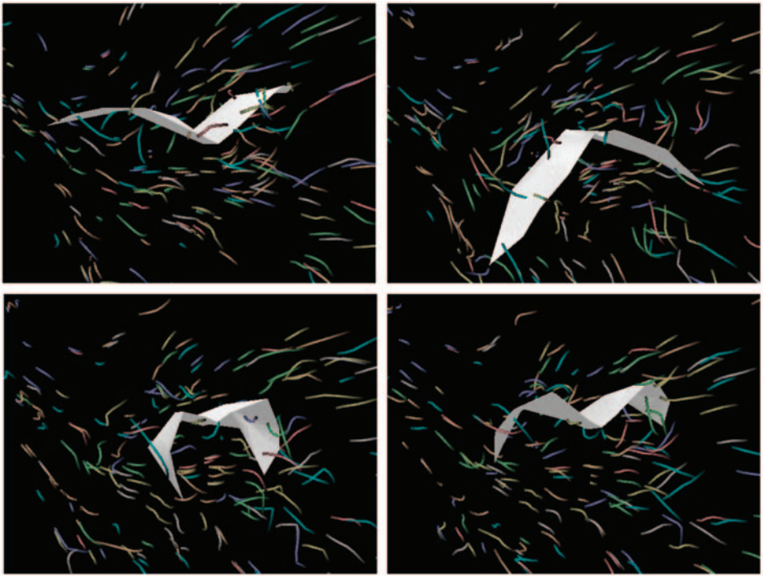
Visualization
Cultural Heritage
http://ivlab.cs.umn.edu/project_virtclassics.php
Medical Imaging
Nasa Mars VR
https://www.youtube.com/watch?t=51&v=UyqjmrPrJ8s

Slide 8
Overview of the Project
Scope: Parameters for Inclusion
Chronological (Classical & Hellenistic Periods, approx. 500 BCE – 100 BCE)
Geographical (all of Greece)
Architectural (some standard building types; some idiosyncratic cases)
Stages & Methods of Inquiry
Identification: Review of the scholarship
Examination: On-site investigation and documentation
Collection/Collation: Especially visual resources
Description → Interpretation: Enhanced by digital modeling
Reconstruction Visualization [Acoustical simulation?]
Interpretation & Evaluation

Slide 9
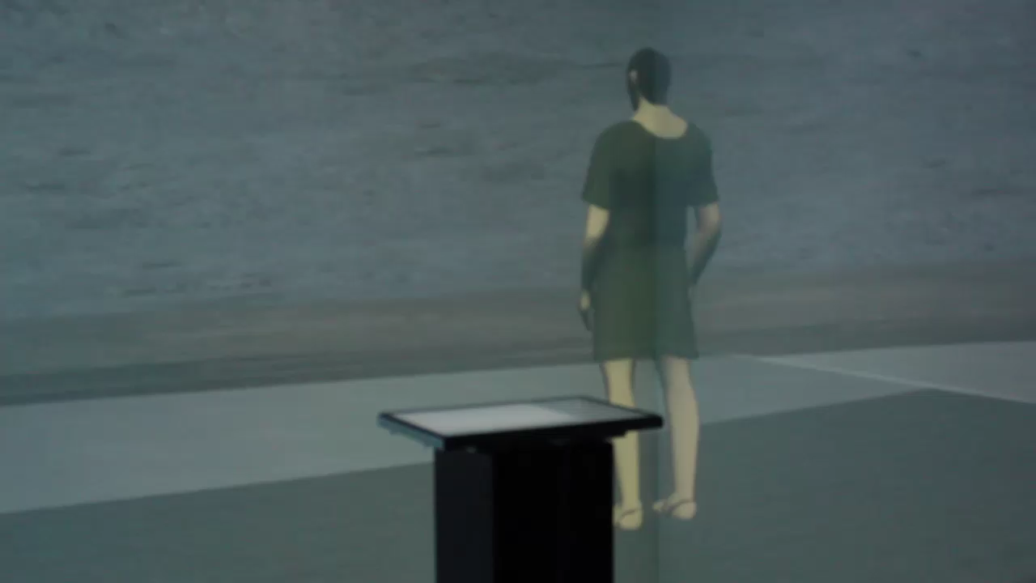

Slide 10
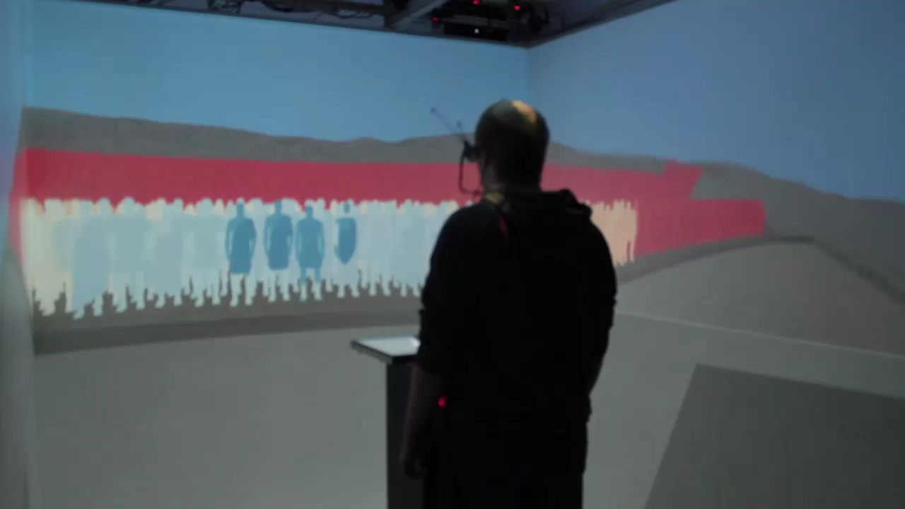
Notes:
Vocal strength and oratorical training were significant factors!
If most of the audience couldn’t understand, what did they base their vote on?

Slide 11
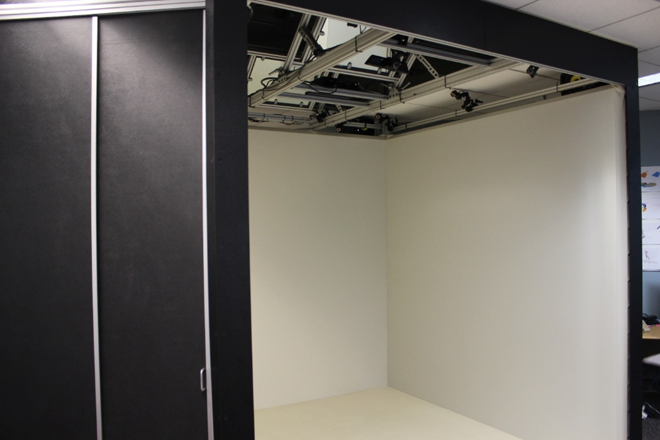
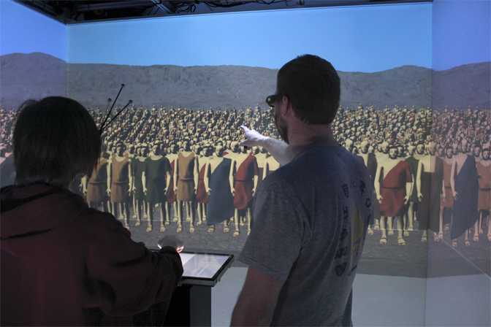
Hardware and First Person Immersion
Bema is designed for use in a 4-wall Cave environment with 6 degree-of-freedom head-tracking.
A podium in the middle of the cave sets an expectation of giving a speech.
A multi-touch display is mounted on a pedestal.
An 8-speaker 3D spatial audio system can be used to hear speeches in a virtual orator mode.

Slide 12
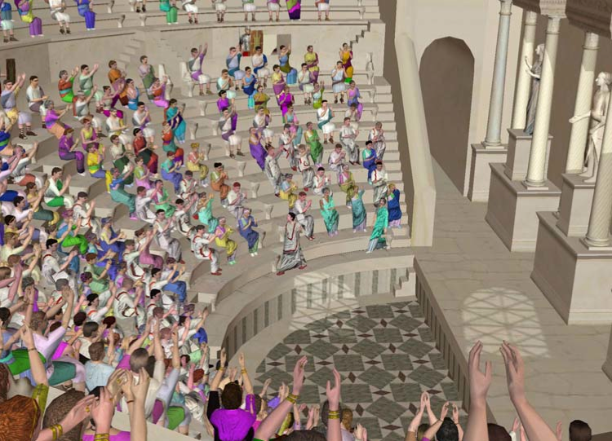
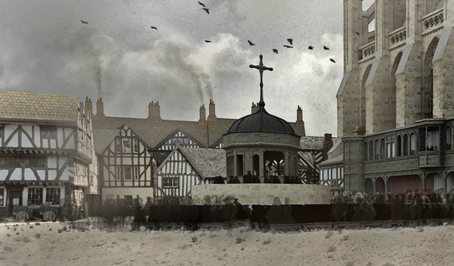
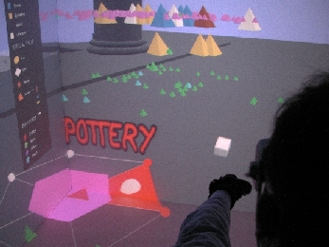
Ancient Worlds and Cultural Heritage
ERATO (EU cultural heritage
project, 2003-2006)
The Virtual Paul’s Cross Project
(Wall et al., 2014+)
ARCHAVE (Acevedo et al., 2001)
In ARCHAVE, archeologists who had been on site at the Great Temple of Petra in Jordan, could relate what they observed in VR to their fieldwork experiences.

Slide 13
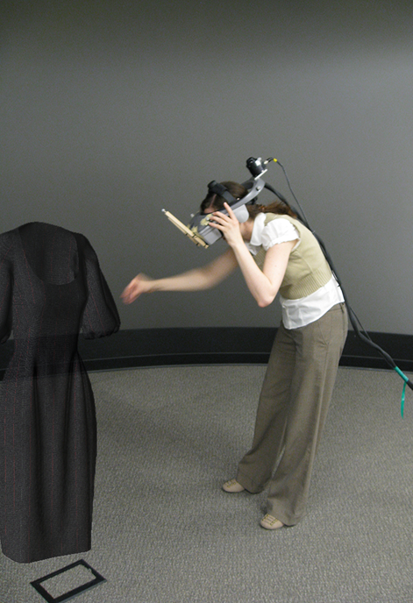
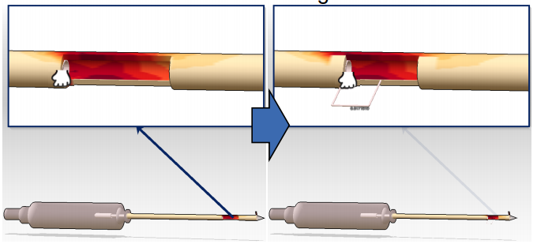
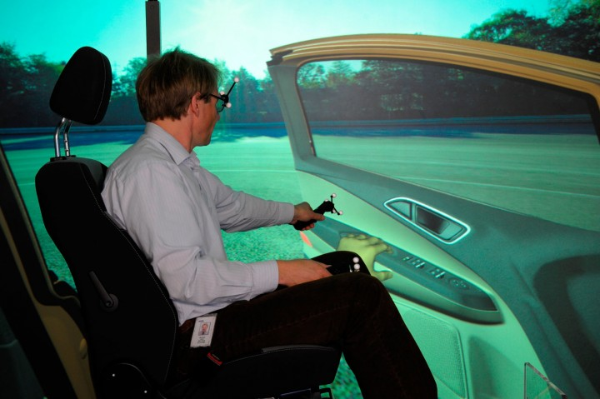
Design and Engineering

Slide 14
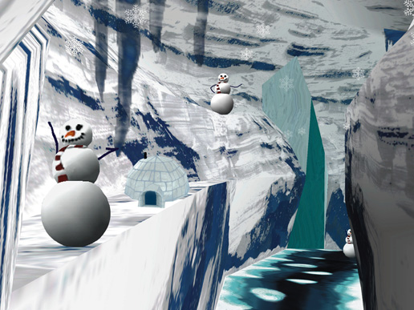
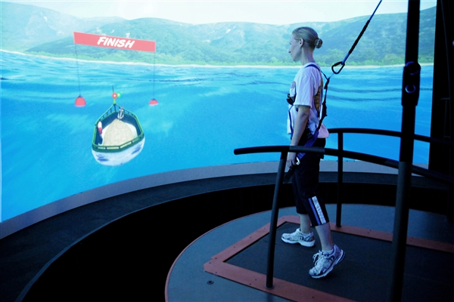
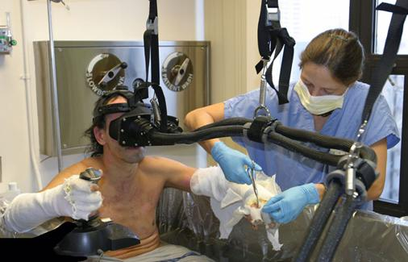
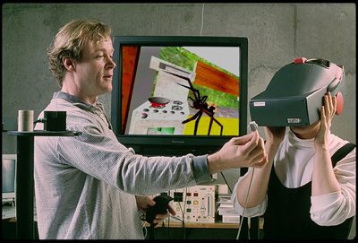
Therapy
Snow World
http://www.nbcnews.com/video/rock-center/49849152

Slide 15
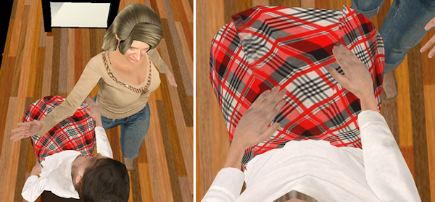
Illusionary Body Transfer
“This work opens up another avenue for virtual reality, which is not just to
transform your sense of place, but also your sense of self. If you can
temporarily give people the illusion that their bodies are different, then the
evidence suggests it also affects their behavior and the way they think. They
can have new experiences: a person who is thin can know what it's like to be fat. A man can have an experience of what it's like to be a woman.” – Mel Slater

Slide 16
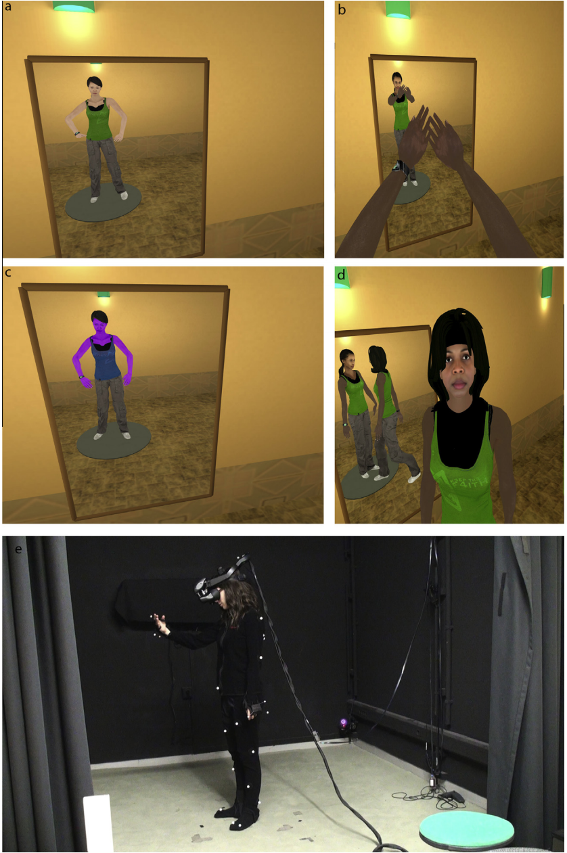
Reducing Racial Bias

Slide 17
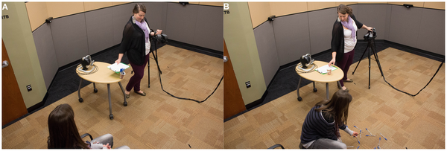
Virtual Superheroes: Using Superpowers in Virtual Reality to Encourage Prosocial Behavior
https://www.youtube.com/watch?v=wnQgDsdy7zg

Slide 18
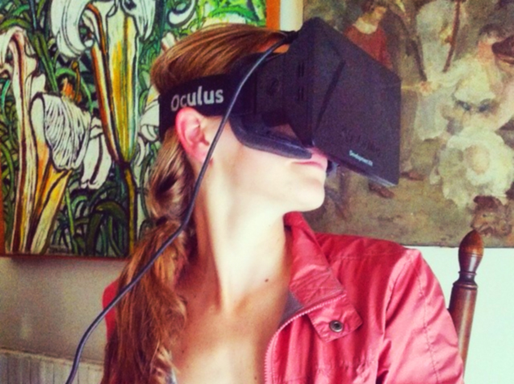
Art
https://drive.google.com/file/d/0B-PV6emGoDKaOW5heTEyTlAyYTA/view
http://virtualrealityderegallery.com/#info

Slide 19
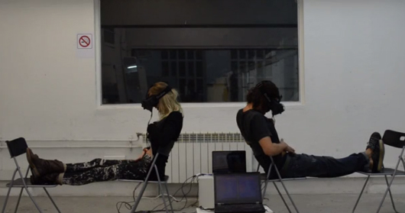
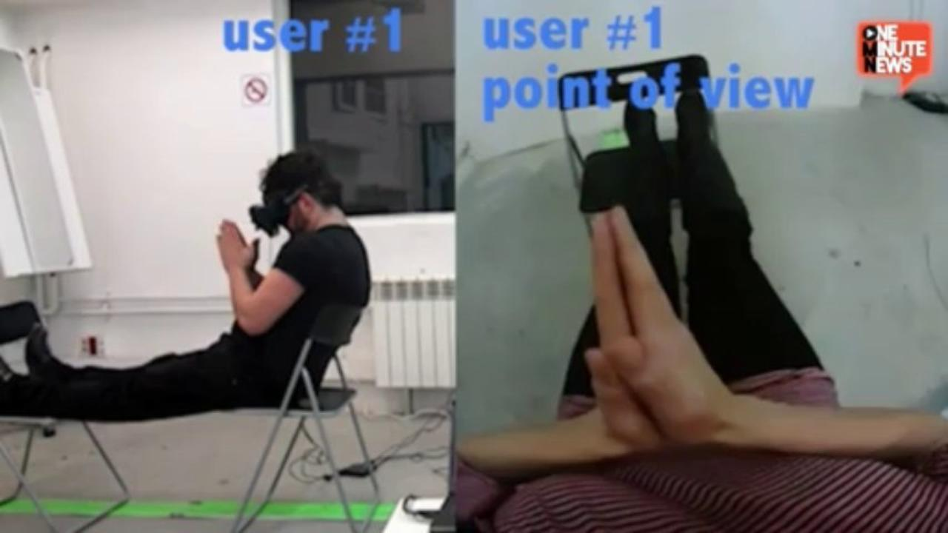
Gender Swap

Slide 20
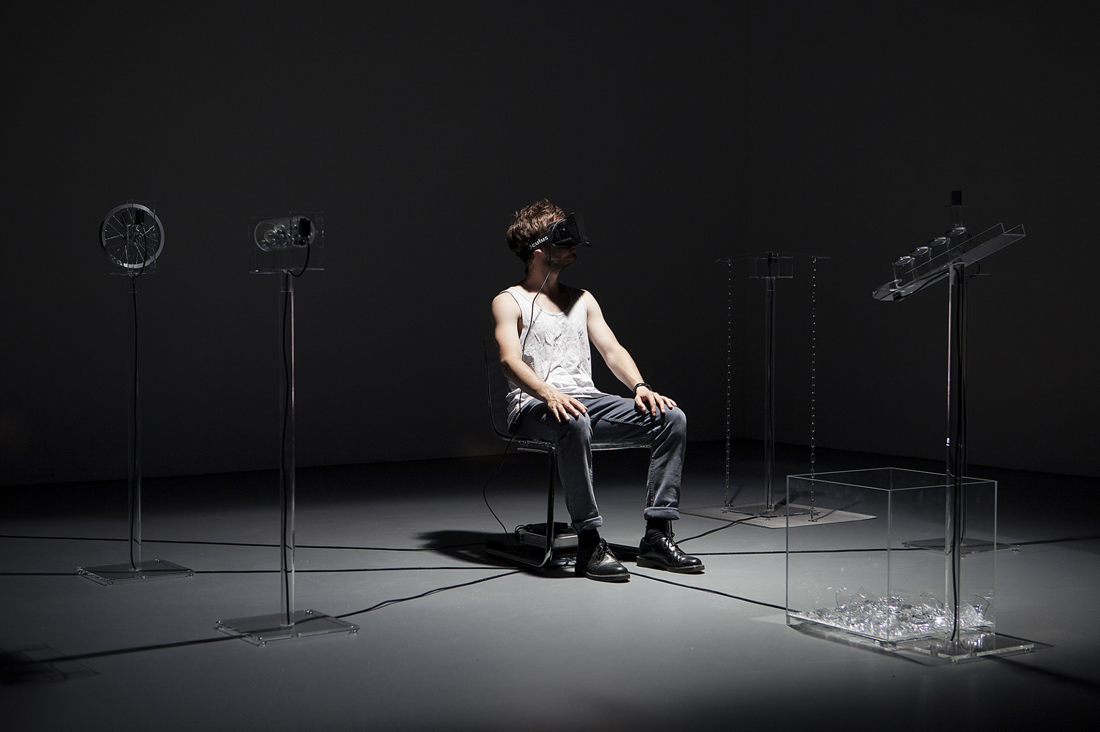
Art
https://vimeo.com/107016236
Users find themselves at the core of a hybrid space, where images and sound, though originating in heterogeneous realities, coincide. Stuck between two worlds, their perception is challenged. The OccultUs experience requests users’ participation in a double way: as the leading actor of the piece, but also as an integral part of it by becoming the object of other spectators’ attention.

Slide 21
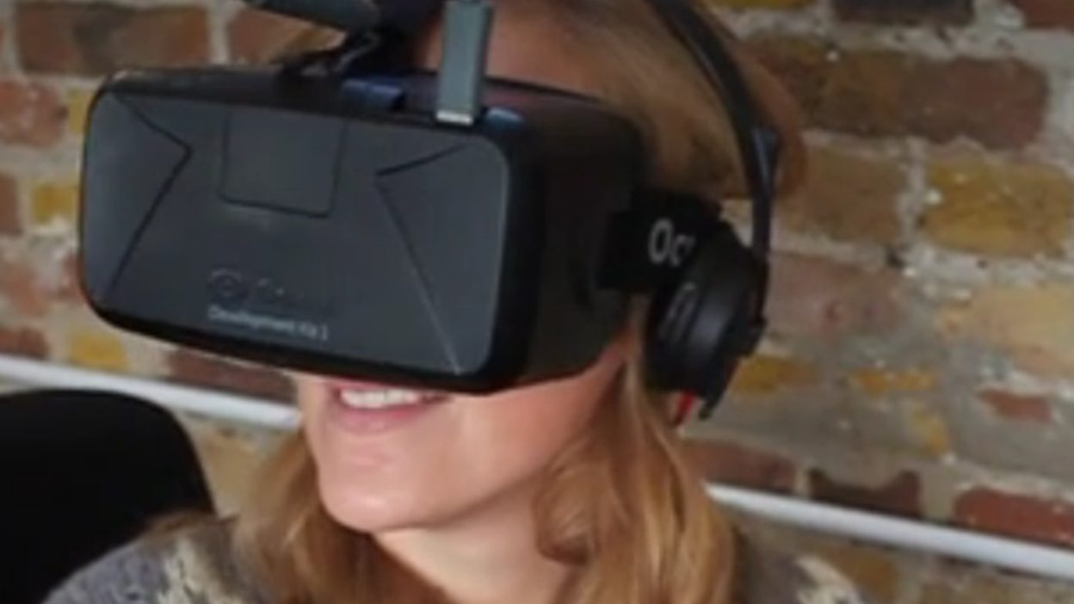
The Styx
https://vimeo.com/97645686

